Slide 1

TestCracker2.0
By YiRan Zheng, DaMin Xu, YaShu Ren, YuTong Gao, Zhou Lu

Slide 2
Our vision:
Test Cracker is an Android application for RPI students to improve efficiency and keep track of important academic events.
We use Java to implement the basic structure of our APP
We also use Python to write a web crawler to get information of courses offered by RPI from SIS

Slide 3
What’s new
Cloud server
Register verification
Post comments
Improved the performance of uploading and downloading
Thumb up and thumb down
Notes:
More friendly to users
Users can share their comment about each paper.Thumb up for good.Thumb down for bad.

Slide 4
New Feature - Cloud Server
Easy to set up
Safe
Convenient to update
Firebase??
Not suitable for this project
Notes:
In proposal we planned to use firebase.
But the format of json indexing is hard to maintenance in this project

Slide 5
Why Not Flask?
Flask is good for beginners.
Light
Fast
However…
Only good for http access(web pages etc.)
Hard to connect with Android application
Notes:
In our proposal, we planned to implement the server using flask.
The flask is light and fast
Only good for http website
Hard to connect with android application
We tried using python and flask to rebuild the server, but the performance of interaction dropped a lot.
In order to keep the stability, we keep using Java.
It’s more suitable for server in this project.

Slide 6

Register Verification
Notes:
RYS
Now we have a verification process for new user registering account.
Here is the video of this process
Users need to enter the code displayed on the image and the server can compare the code with data stored in our database.
Only when they matched, the user can register their account successfully.

Slide 7
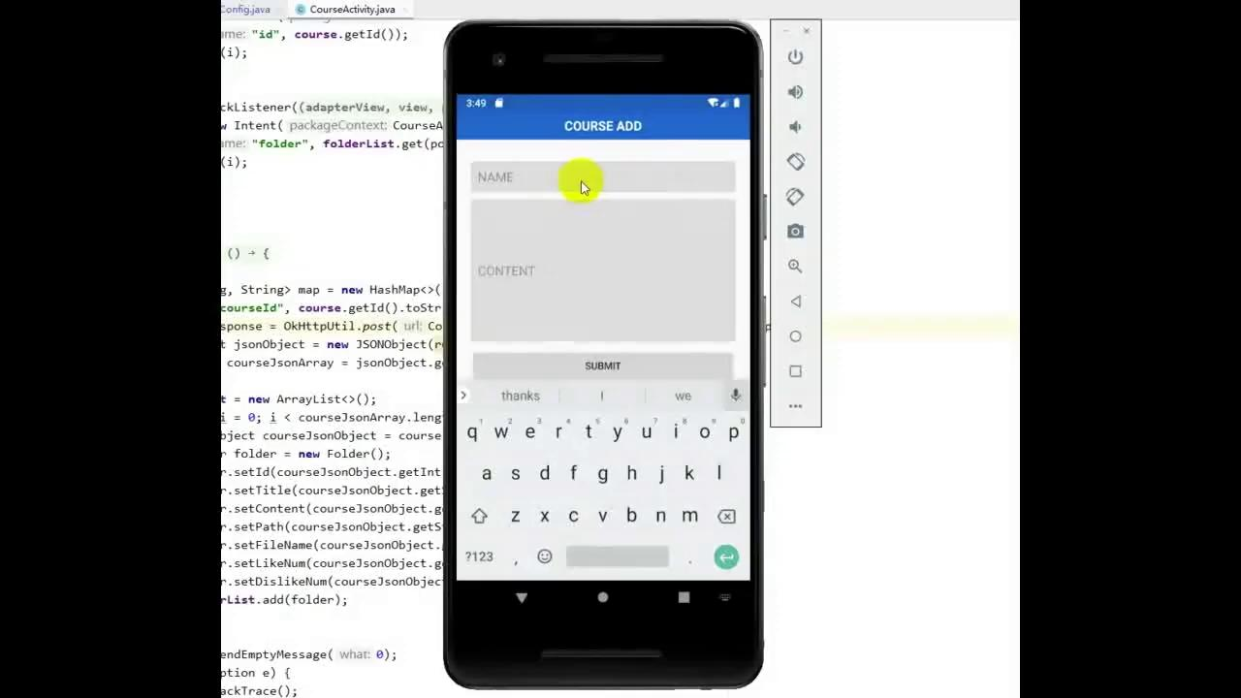
New Post
Notes:
XDM

Slide 8
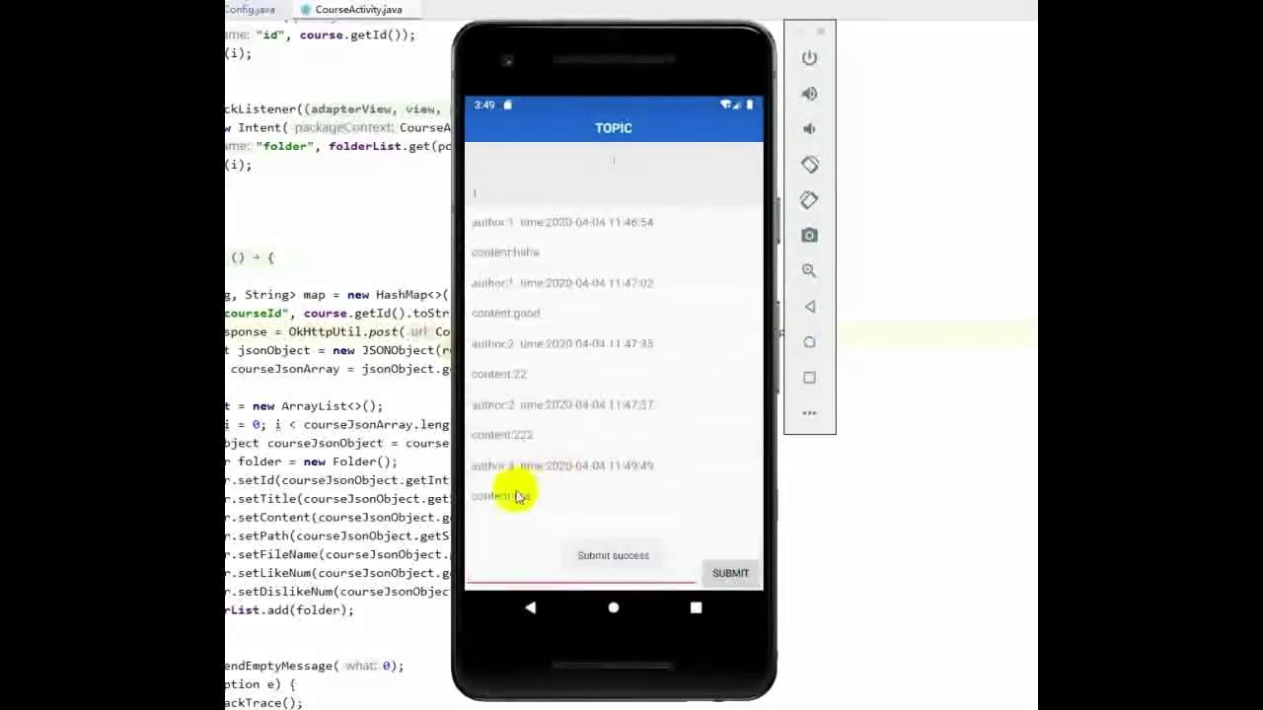
Reply Existing Posts

Slide 9
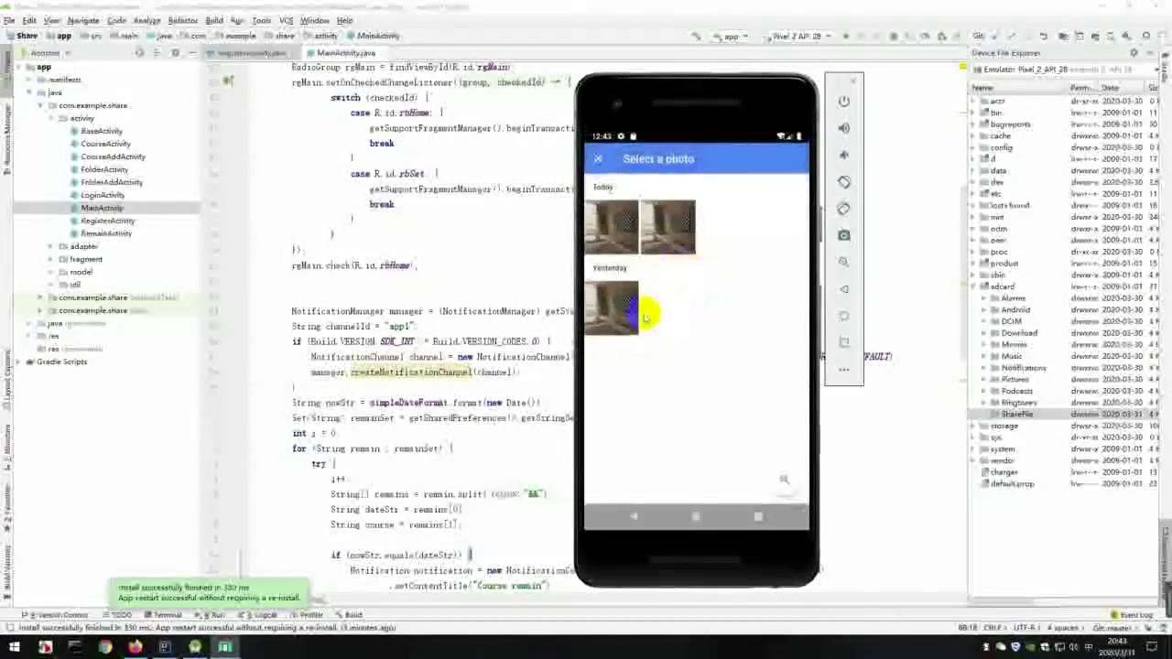
Upload
Notes:
上传

Slide 10
Download and thumb up
Notes:
点赞下载

Slide 11
Documentation
Vision statement, Major product risks, Business case, Project schedule
Static class diagrams, Sequence diagrams, CRC cards
Test plan, Test strategy, List of Test Cases
Link to repo:https://github.com/Sakurailulu/RCOSTestCracker2.0

Slide 12
Thank you
Stay safe

